Slide 1
Scrum Team 2 Product Release
Scrum Master :
Elgin Bowman
Development Team :
Scott Troutman, Adam Ingram, Johnny Hosler, Brandon Taylor, Pengzheng Yang, Zachary Alwine

Slide 2
Overview
ArgumentParser allows for the creation of different types of arguments and store data parsed from the command line.
Allows created arguments to be saved to and loaded from an XML file using the XMLManager class.
In-depth documentation Link

Slide 3
Features
Positional Arguments
Holds a name, description, and data type
Can be restricted to a certain set of values
Throws exception if value provided doesn’t match data type
Throws exception if too few/many positional arguments are used

Slide 4
Features
Named Arguments
Inherits functionality from positional arguments
Stores a default value
Can be assigned and called by a pre-defined shorthand name
Can be set to be required
Can store multiple values
Can be assigned to a mutually exclusive group

Slide 5
Testing & Code Coverage
100% Pass rate on unit testing
100% Pass rate on acceptance testing
97% Code coverage

Slide 6
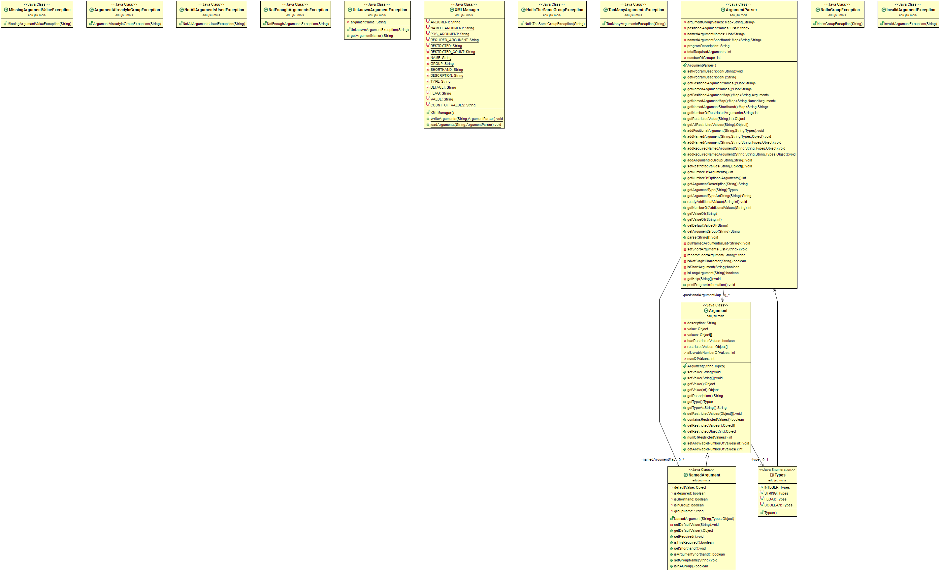
Class Diagram

Slide 7
Class Diagram
Part A.
Part C.
Part B.
Part D.

Slide 8
Class Diagram (Part A)

Slide 9
Class Diagram (Part B)

Slide 10
Class Diagram (Part C)

Slide 11
Class Diagram (Part D)

Slide 12
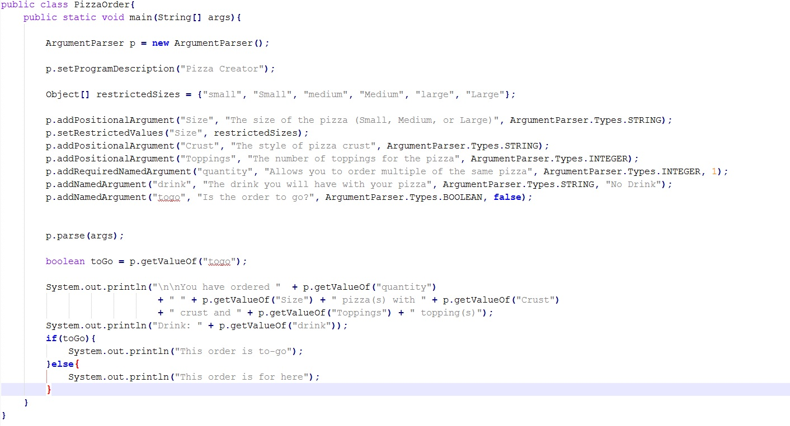
PizzaOrder Demo

Slide 13
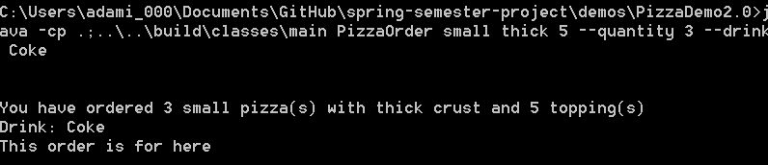
Demo Use Example
Example of how a user might use our PizzaOrder demo

Slide 14
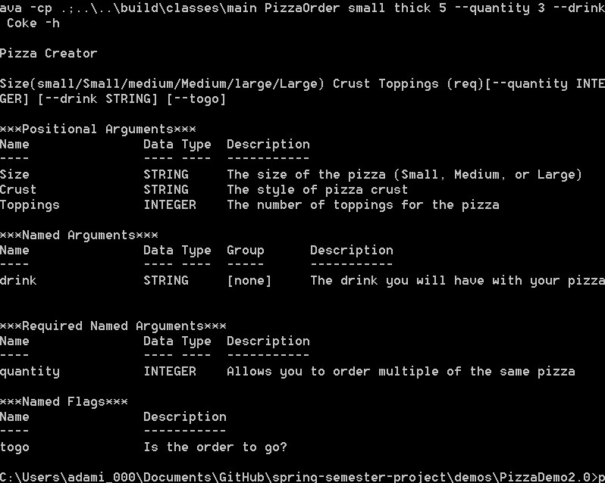
Using - -help or -h
Calling for help exits the parser and opens a help menu

Slide 15
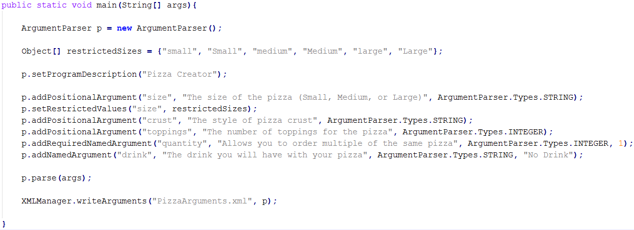
Writing Arguments

Slide 16
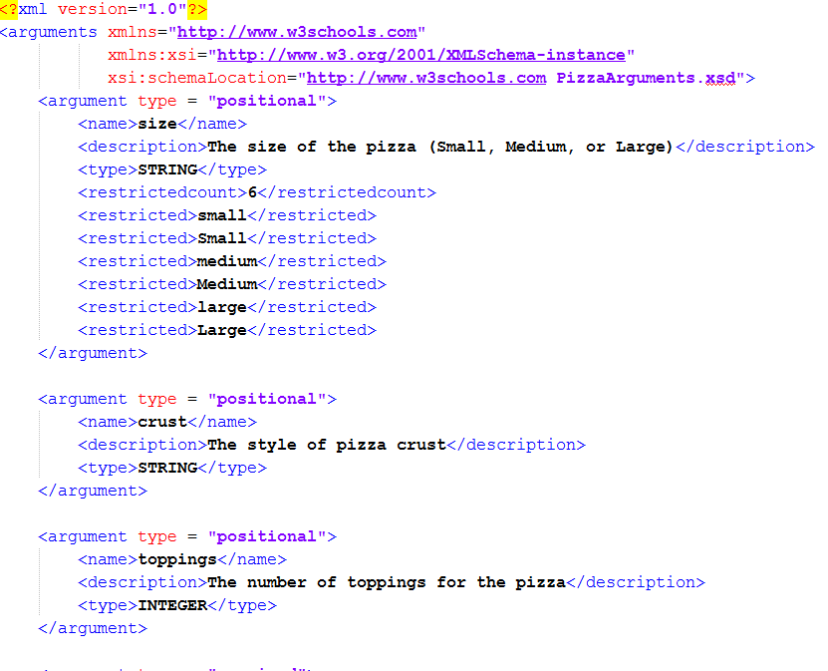
Running XML Write Demo
Ran with parameters:
Result: XML File

Slide 17
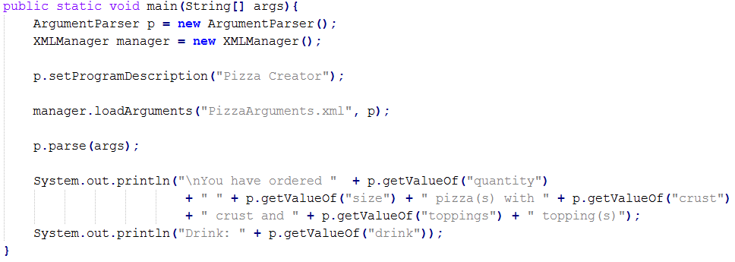
Loading Arguments

Slide 18
Running XML Load Demo
Ran with parameters:
Result:

Slide 19
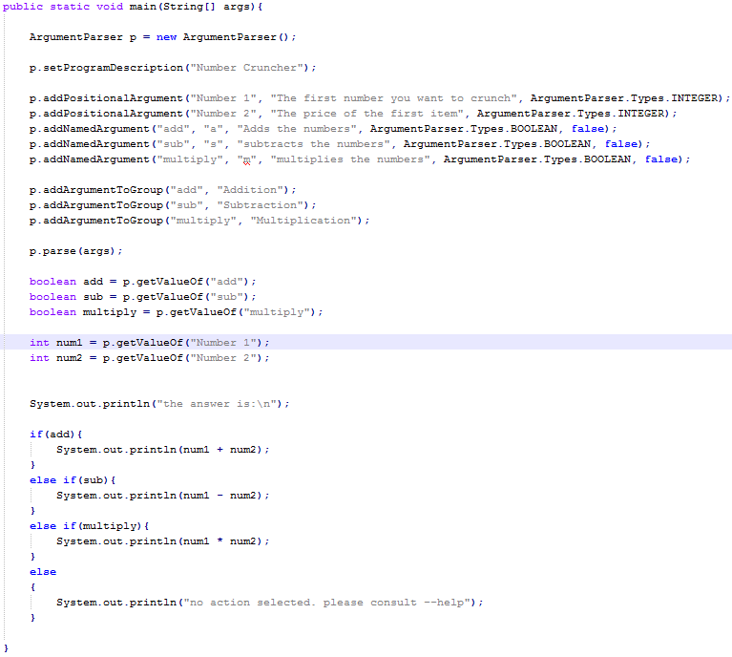
Mutually Exclusive Demo Using Shorthand Arguments

Slide 20


Running the Addition Demo
Ran with parameters:
Result:

Slide 21


Running the Subtraction Demo
Ran with parameters:
Result:

Slide 22

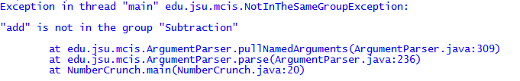
Failing Mutual Exclusion
Trying to run previous demo with parameters:
Result

Slide 23
Agile Estimating and Planning Technique
Story Points
Planning Poker
1 = easy
2 = fairly easy
3 = moderate
5 = fairly difficult
8 = difficult
Total of 78 story points

Slide 24
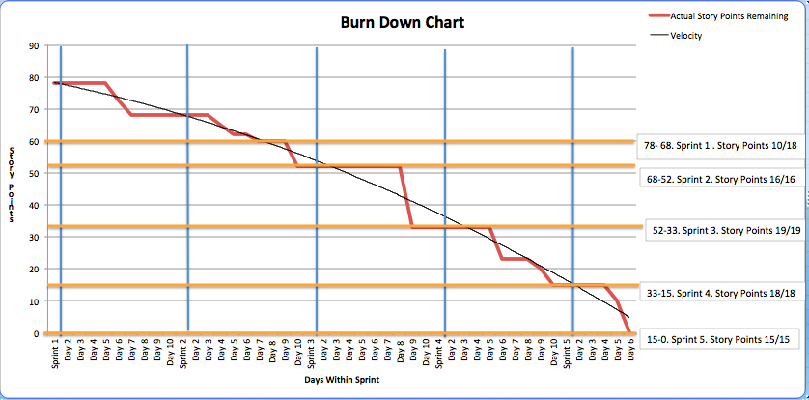
Burndown Chart

Slide 25

Thank You For Your Time

